Slide 1


Used Car Price Prediction using Machine Learning
Using Random Forest and Linear Regression to forecast market values, enhancing transparency in the pre-owned car trading process.
By Alakananda T N

Slide 2
Problem Statement: Predicting Used Car Prices
1
Challenges in Price Prediction
2
Social Impact
Predicting used car prices accurately is complicated due to factors like mileage, age, and market trends, leading to pricing discrepancies.
Machine learning-based price prediction fosters trust and transparency, empowering consumers in the pre-owned car market.

Slide 3



Data Collection
The vehicle dataset from kaggle contain 4340 rows and 8 columns.

Slide 4


Data Preprocessing
Data Cleaning
Handle missing values, remove duplicates, and outliers that may skew the analysis.
Feature Engineering
Create new features and transform existing ones to extract meaningful information from the data.
Encoding Categorical Variables
Convert categorical variables into numerical representations using techniques like dummy encoding .

Slide 5
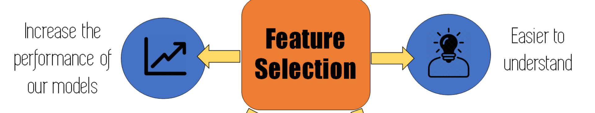
Feature Engineering
1
Deriving Key Feature
Create a new feature representing the age of the car to understand its impact on pricing. Derive a new feature representing the age of the car by subtracting the manufacturing year from the current year.

Slide 6
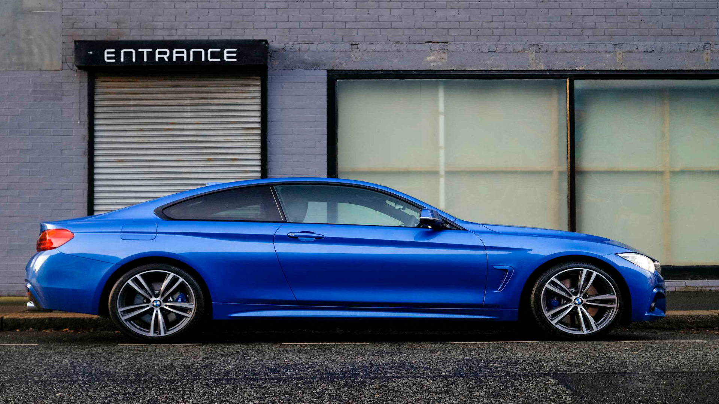
Model Selection and Training
Data Splitting & Model Selection
Model Training & Evaluation
Separate the dataset into features and select a suitable machine learning algorithm for the prediction task.
Train the models with training data and evaluate their performance using testing datasets.

Slide 7

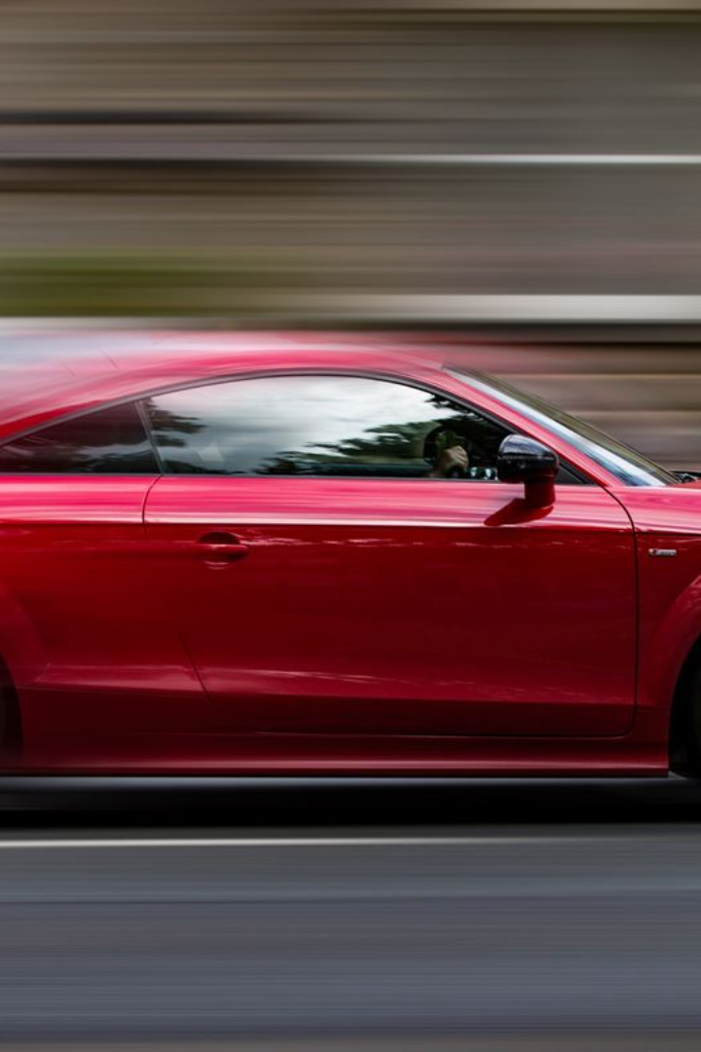
MODELS
Linear regression
Utilizes a linear relationship between features and target to predict outcomes, providing insights into direct feature contributions.
Random forest model
A versatile ensemble learning technique employing multiple decision trees, adept at capturing nonlinear relationships and providing robust predictions with feature importance insights.

Slide 8

Evaluation Metrics and Results
Model
RMSE
R-Squared
Adj. R-Squared
OLS
418241.245
0.422
0.413
Random Forest
281565.6
0.738
0.734
The best model achieves the right balance between prediction accuracy and goodness of fit, ensuring reliability for the specific problem and requirements.

Slide 9

Discussion of Challenges and Limitations
1
Complexity of Data
2
Nonlinear Relationships
Linear regression may not capture the complexities of the data, necessitating consideration of alternative models.
Data with nonlinear relationships challenges the assumptions of linear regression and warrants exploration of alternative models.

Slide 10
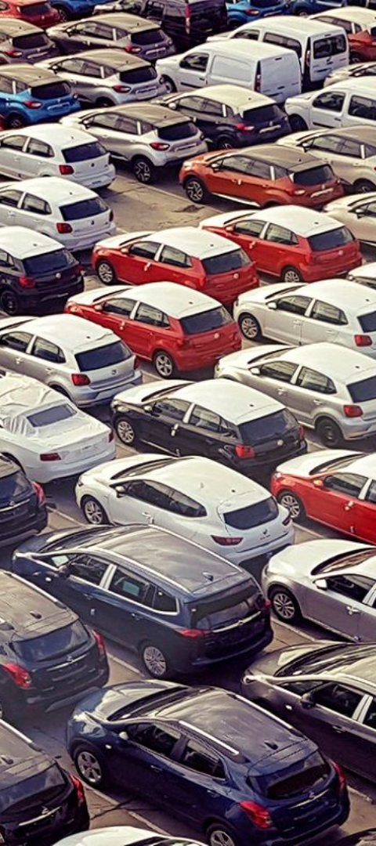
Conclusion
1
Performance Superiority
2
Market Impact
Random Forest offers superior performance compared to linear regression, handling nonlinearity and complexity with accuracy.
Enhanced estimates empower buyers and sellers, fostering trust and efficiency in the pre-owned car market.

